Slide 1
PROPOSAL
PROPOSAL
16102279 Son MinSang
17102061 Lee YeongMin

Slide 2
Background & Purpose
Background
Purpose
2. About Application
Description
Competitive Analysis
Expectation
3. Schedule
Contents

Slide 3
1
Background & Objective

Slide 4


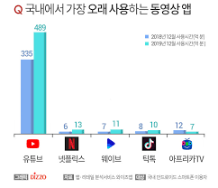
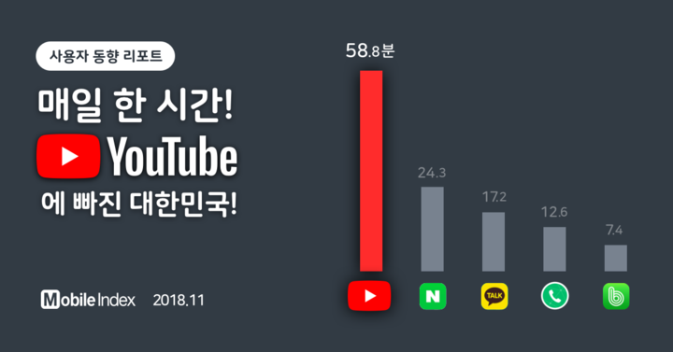


[ Growth of ]
1. Background & Objective
Background
Application
Schedule
Notes:
국내 동영상 어플을 기준 뿐만 아니라 다른 어플들 중에서도 유튜브 이용율이 압도적으로 높다.

Slide 5
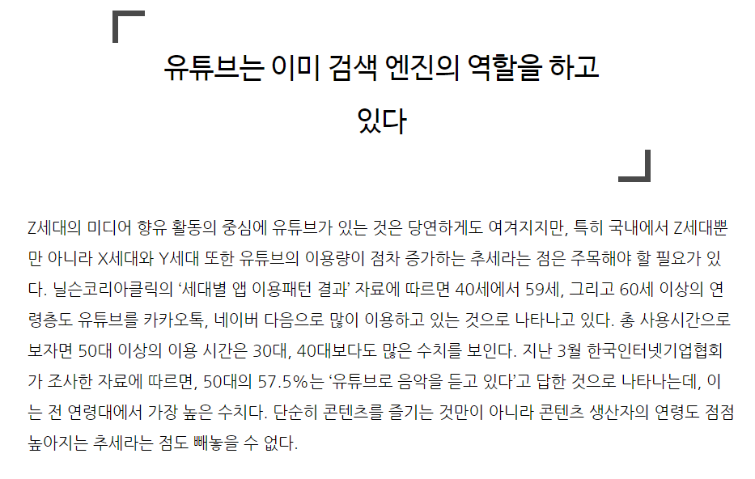
[ Growth of ]
1. Background & Objective
Background
Nowadays, people find Youtube when not only they want to spend their free time, but also they need some information.
The activities that were executed in search engine like Google, or Naver before be done now in Youtube.
Application
Schedule
Notes:
또한 유튜브는 단순히 오락 목적을 넘어 검색엔진의 역할까지 확장되고 있다.

Slide 6
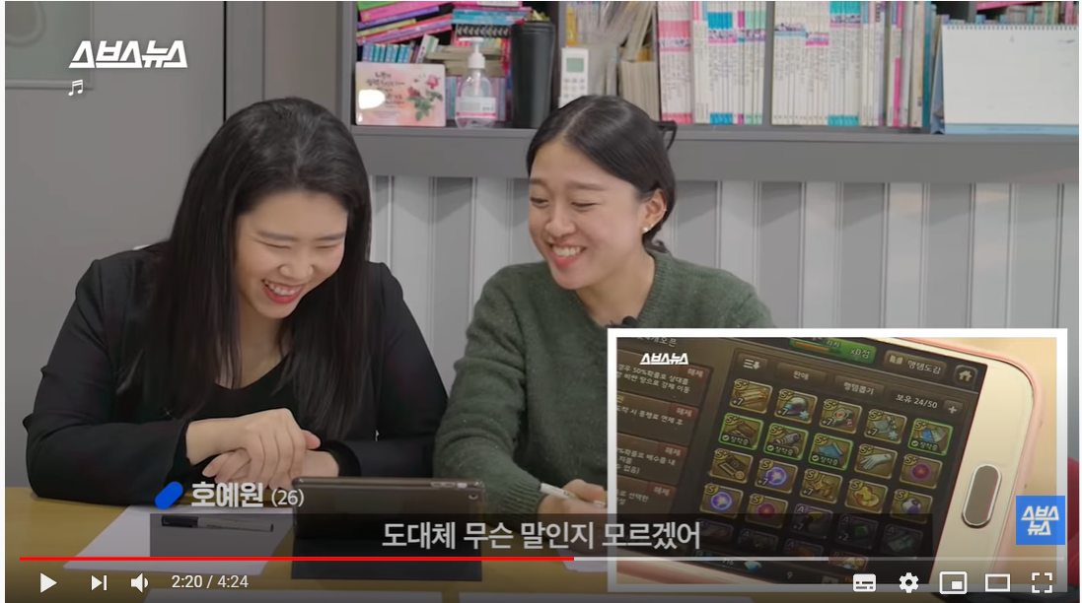
1. Background & Objective
[The Occurrence of the Information Disadvantaged]
Background
Application
Now, the number of hearing-impaired people takes up about 1% of total number of Korea population.
The video make by 스브스뉴스 contains the difficulty of the hearing-impaired people occurred when they watch Youtube.
스브스뉴스 channel provide the barrier-free subtitles in all the videos they have.
Schedule
Notes:
국내 청각장애인은 매년 증가하고 있지만
대부분의 유튜브 영상들은 한국어 자막을 제공하는 경우가 드물다.
스브스뉴스와 같은 대형 방송사 채널의 경우 자막을 제공하지만
대부분의 영상들은 한국어 자막이 없어 청각장애인이 이용하기 어렵다.

Slide 7
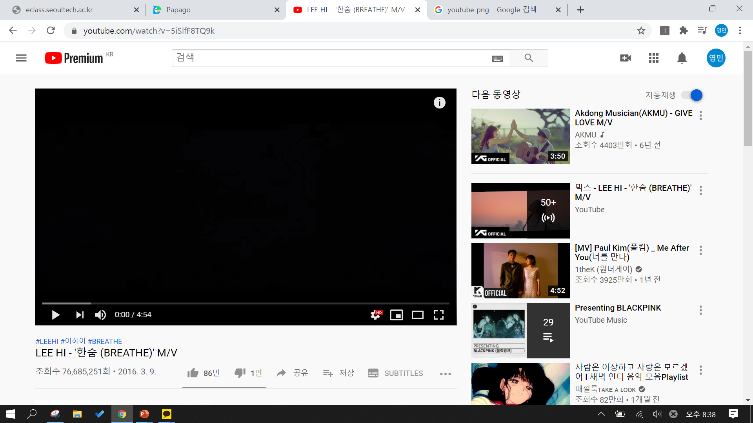
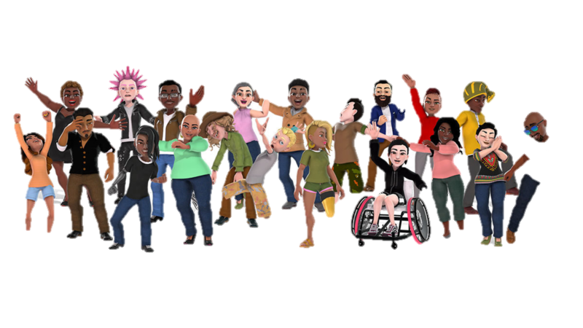

[ Objective ]
1. Background & Objective
Background
Application
Improve Quality
For Everyone
Schedule

Slide 8
2
About Application

Slide 9



2. About Application
[ About Application ]
Background
“SUBTITLE For Everyone”
Everyone can make Subtitle
Everyone can use Subtitle
Everyone can enjoy Youtube
Application
SuperTitle
Schedule
Notes:
누구든 자막이 필요한 영상이 있으면 요청을 올리고
누구나 영상에 자막을 만들 수 있습니다.
장애가 있든 없든 누구나 어플을 이용해 자막을 즐길 수 있습니다.
자막을 만들기 위해 어플을 설치한 사람들은 요청이 올라온 영상의 자막을 만들고 리워드를 받고!
자막이 필요해 어플을 설치한 사람들은 이 어플을 통해 자막이 있는 유튜브 영상을 즐길수 있습니다.
자막이 필요한 영상을 요청하면 자막을 제작해 올려드립니다@

Slide 10



[ Benefits ]
2. About Application
Background
Application
Subtitle Requester
- For deaf people, the range of Video available increases. - Help build a Barrier-Free Society
Youtube Creator
- Increasing the number of people using Video →Increase the number of views →Revenue growth
Subtitle Maker
- make profit by making subtitle
Schedule

Slide 11
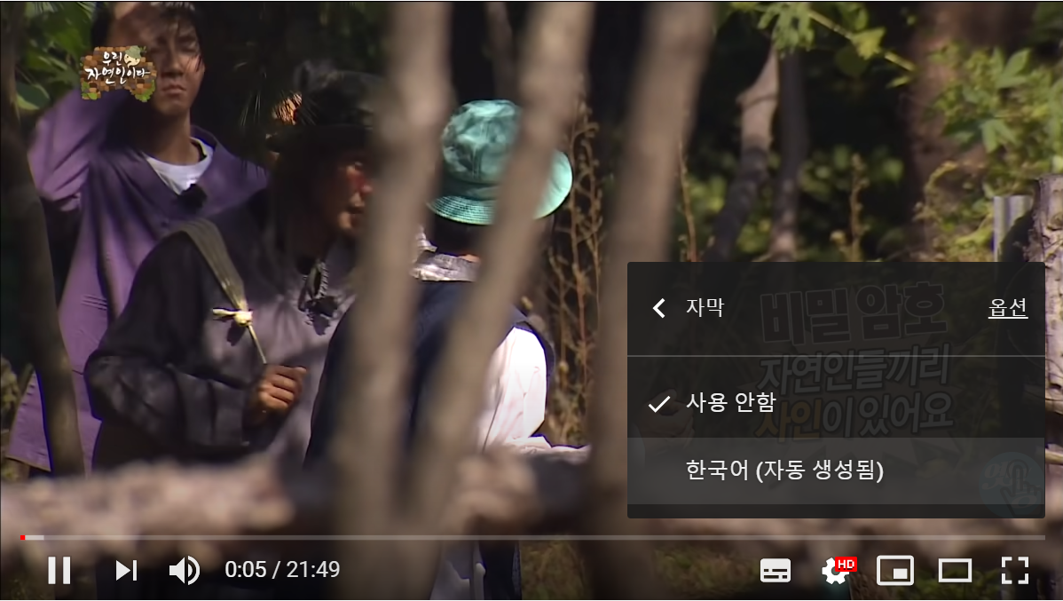
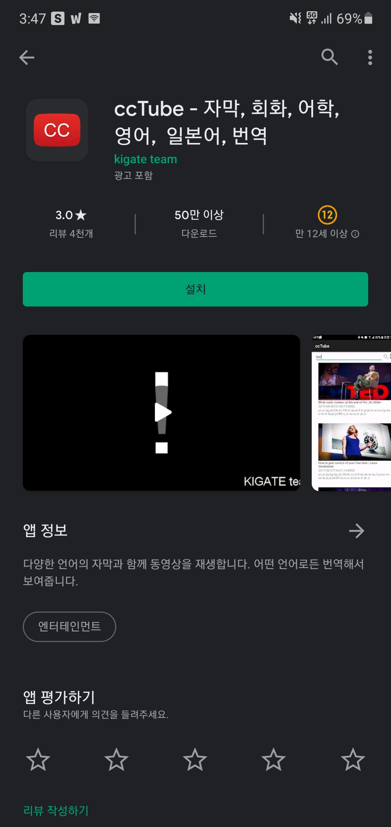
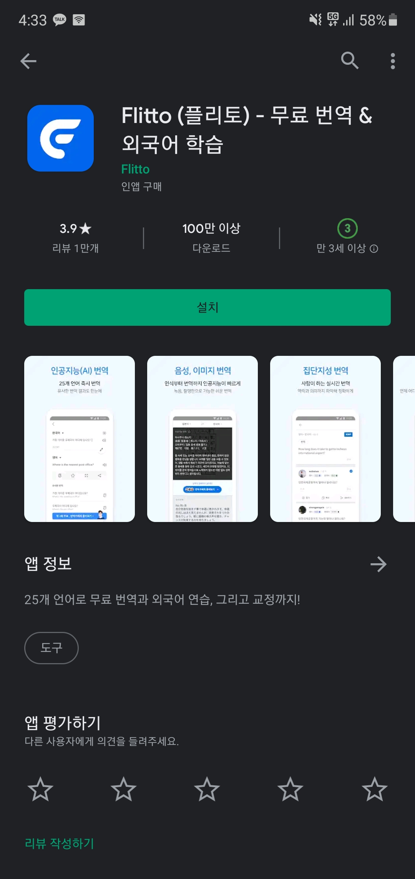
2. About Application
[ Other Application ]
Background
Application
Youtube
Automatic Caption
ccTube
Flitto
Schedule

Slide 12
2. About Application
[ Other Application – Youtube Automatic Caption ]
Background
The ability to automatically convert the voice into letters and subtitle it. Poor accuracy because voice is automatically converted to letters
Application
Schedule

Slide 13
2. About Application
[ Other Application – CCTube ]
Background
If there are subtitles in the video, it will be translated into the desired language. Translated into Korean only if there are subtitles in other languages.
Application
Schedule

Slide 14
2. About Application
[ Other Application – Flitto]
Background
Used by the video producer to provide multilingual subtitles in the video. Multi-language subtitles available at a low price Service of Video owner
Application
Schedule

Slide 15
3
Schedule

Slide 16
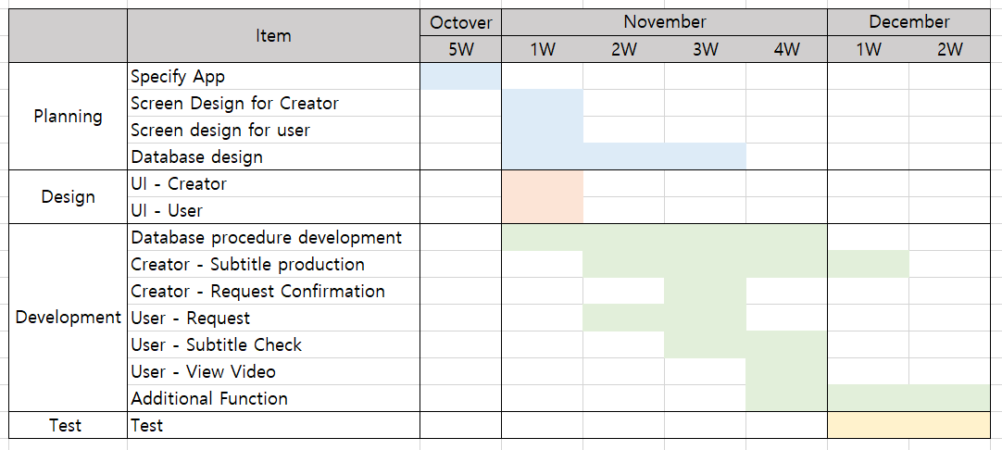


3. Schedule
Background
Application
Schedule

